Slide 1

BRITISH AIRWAYS
Customer ratings analysis
13.01.2024

Slide 2
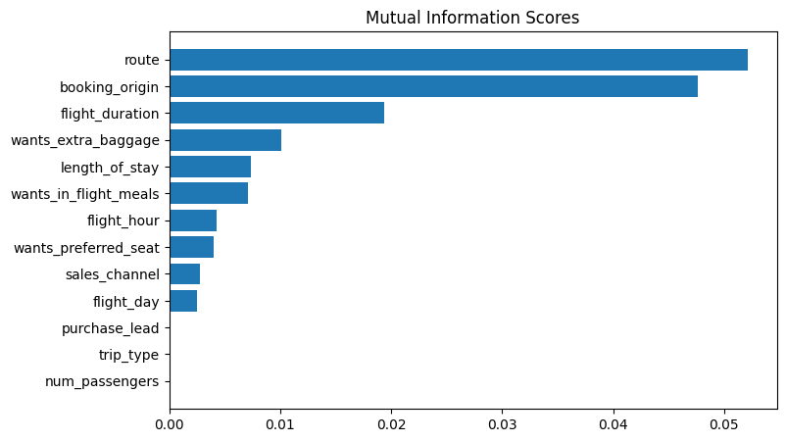
predictive model to understand factors that influence buying behaviors
Trained data shows that Random forest classifier model has the highest
ACCURACY: 85.08
AUC score: 0.5578
TOP 5 FEATURES THAT INFLENCE CUSTOMERS BEHAVIOUR
route
booking_origin
flight_duration
wants_extra_baggage
length_of_stay

